Slide 1
Semester Project: Speech to Text Converter and Translator
Rene Escobedo Trujillo

Slide 2
Libraries
SpeechRecognition
Google Speech Recognition API
Translate
MyMemory API

Slide 3
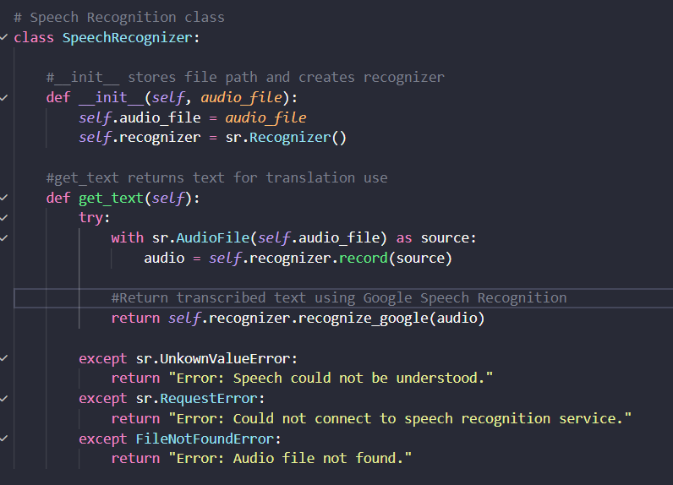
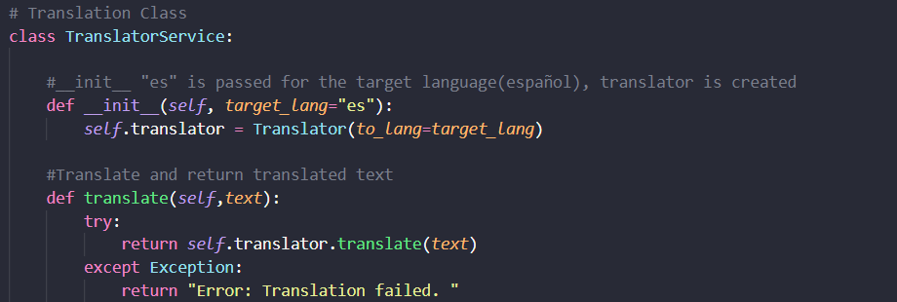
Core Code

Slide 4
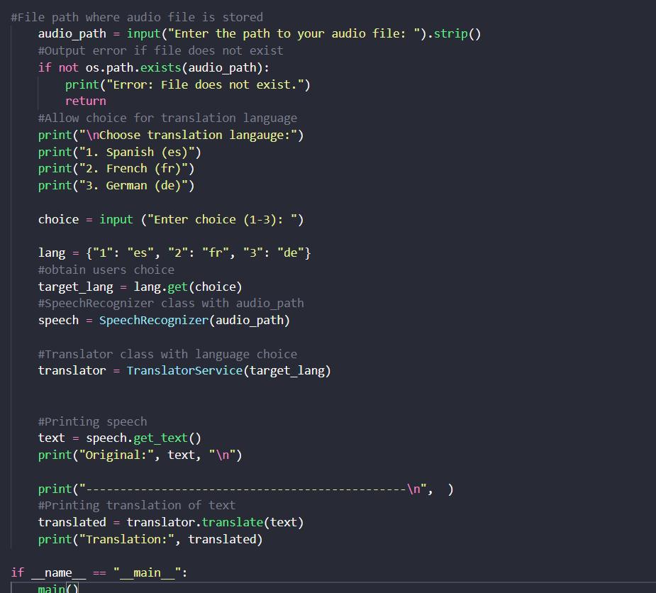
Core Code

Slide 5
Pipeline
Audio File
SpeechReconizer
Text
TranslatorService
Translated Text

